Slide 1


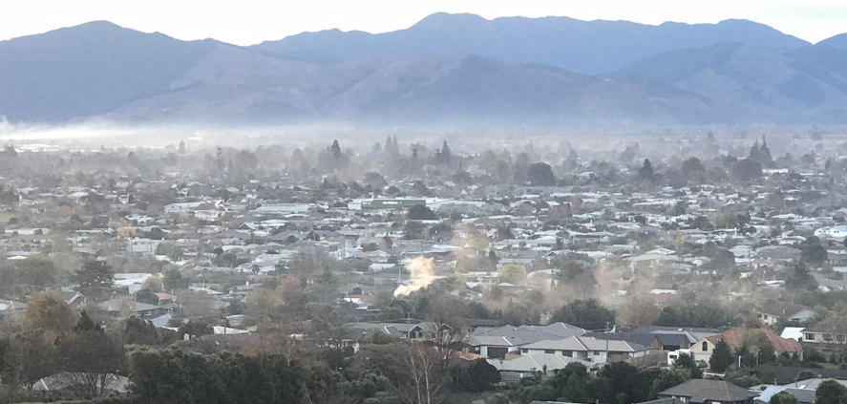
2023 Annual Air Quality Report for Blenheim
marlborough.govt.nz

Slide 2
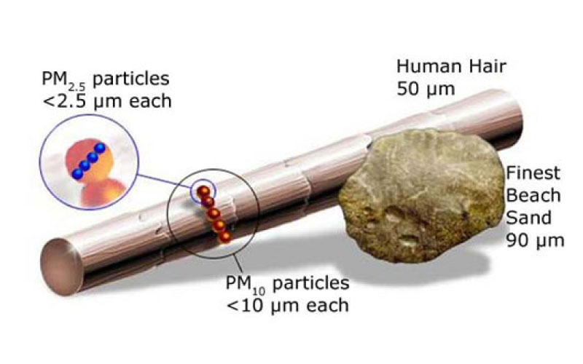

National Environmental Standard for Air Quality (NESAQ)
The main contaminant of concern for New Zealand is particulate matter (PM).
The NES currently focuses on PM₁₀ with a standard of 50 µg/m³ 24 hr average (1 allowable exceedance per year) and an annual average of 20 µg/m³.
However, the smaller fraction of PM₁₀ particles, those less than 2.5 microns in diameter (PM_{2.5}), are a stronger indicator of health impacts.
In Blenheim during the winter the majority of PM₁₀ is comprised of PM_{2.5} reflecting the residential domestic heating source.
marlborough.govt.nz

Slide 3

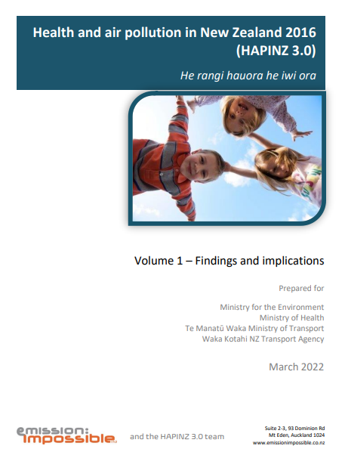

Potential changes to the NES
In 2020 the Ministry for the Environment (MfE) proposed amending to the NES to move the focus to PM_{2.5}.
  PM_{2.5} 24 hr average standard of 25 μg/m³ (3 allowable exceedances per year).
  Annual average PM_{2.5} standard of 10 μg/m³.
Several reports released since may significantly change the proposed standards.
  Revised WHO Air Quality Health Guidelines 2021 - significantly lower standards.
  Updated Health and Air Pollution in New Zealand study (HAPINZ 3.0) 2022 showed significant costs to population morbidity and health from particulate matter especially PM_{2.5.}
MfE have currently not given any further updates to either the standards proposed considering the above reports, nor a time frame for any amendments.
The new coalition Government’s RM reform will also affect any amendments timeline.
marlborough.govt.nz

Slide 4
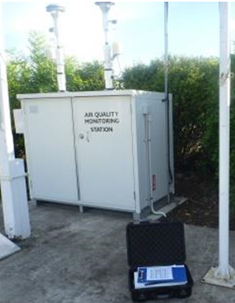
Blenheim Monitoring Station
Both PM₁₀ and PM_{2.5} are monitored at the Redwoodtown Bowling Club site.
Blenheim was required to be compliant with the NES by September 2016.
Historically Blenheim has been non-compliant with the NES for PM₁₀.
marlborough.govt.nz

Slide 5
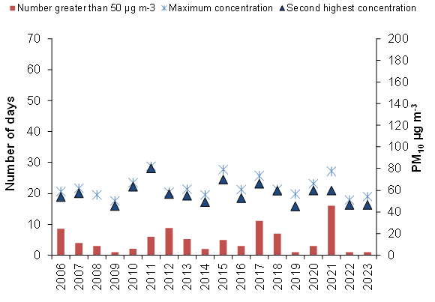
Number of days when 50 µgm³ was exceeded, the maximum concentration and the second highest concentration from 2006 to 2023
marlborough.govt.nz

Slide 6
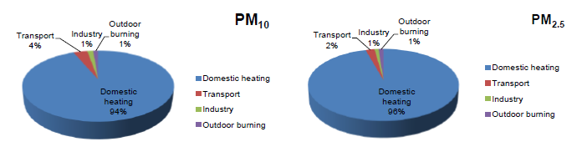
Where is the PM coming from?
Air Emission Inventories are used to determine the source proportion of air pollutants. These are carried out every five years.
Blenheim’s most recent Air Emission Inventory was completed in 2022.
Domestic heating was found to be the main source of daily winter PM emissions, accounting for 94% of the daily winter PM₁₀ and 96% of the daily winter PM_{2.5}.
Industrial, transport and outdoor burning sources make up the remaining percentages.
marlborough.govt.nz

Slide 7
Result for 2023 – PM₁₀
There was 1 exceedance of the 50 μg/m³ PM₁₀ standard on 5 July 2022 – Max concentration of 54.5μg/m³.
The NES allows for one exceedance per year, however this year does constitute a breach of the NES as it occurred less than a year after the previous exceedance, which occurred on the 7 July 2022.
The annual average PM₁₀ concentration was 14 μg/m³ ⁻ lowest annual average recorded at this site.
Year | No. of PM₁₀ exceedances | No of breaches of the NES | Maximum PM₁₀ μg/m³ | Annual average PM₁₀ μg/m³
2017 | 11 | 10 | 74 | 20
2018 | 7 | 6 | 61 | 19
2019 | 1 | 0 | 54 | 18
2020 | 3 | 2 | 66 | 18
2021 | 16 | 15 | 78 | 19
2022 | 1 | 0 | 51 | 15
2023 | 1 | 1 | 54.5 | 14
marlborough.govt.nz

Slide 8
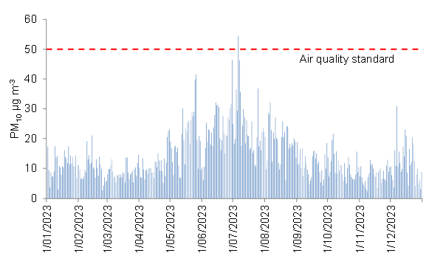
24-hour average PM₁₀ concentrations measured at the Redwoodtown – Bowling Club site during 2023
marlborough.govt.nz

Slide 9
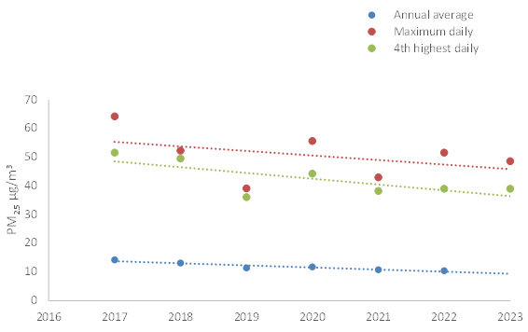
Result for 2023 – PM_{2.5}
There is currently no NES PM_{2.5} standard however the proposed changes are a daily average of 25 μg/m³ and an annual average of 10 μg/m³.
The daily average exceeded 25 μg/m³ on 15 occasions in 2023 (part record), with maximum measured concentration of 49 μg/m³ on the 5 July 2023.
PM_{2.5} has been measured in Blenheim since 2017, with data suggesting as downward trend.
Year | No. of PM_{2.5} exceedances above 25μg/m³ | Annual average PM_{2.5} μg/m³
2017 | 72 | 14
2018 | 61 | 13
2019 | 33 | 11.5
2020 | 45 | 11.8
2021 | 38 | 10.8
2022 | 27 | 10.5
2023 | 15* | 11*
* Only part year measured
marlborough.govt.nz

Slide 10
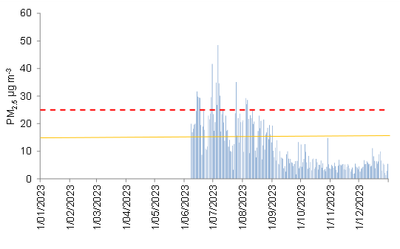
24-hour average PM_{2.5} concentrations measured at the Redwoodtown – Bowling Club site during 2023
- - - Dashed red line is the MfE 24-hour average proposed NES for PM_{2.5} – 15 Exceedances recorded
____ Orange line is the WHO daily PM_{2.5} guideline – 63 Exceedances recorded (Both only part year record)
marlborough.govt.nz

Slide 11
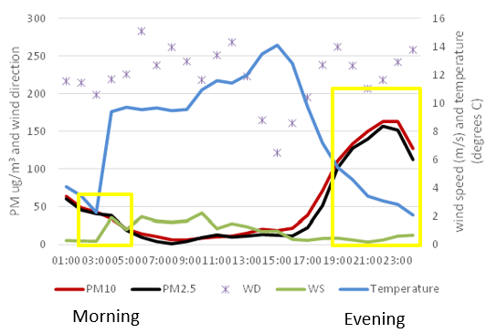
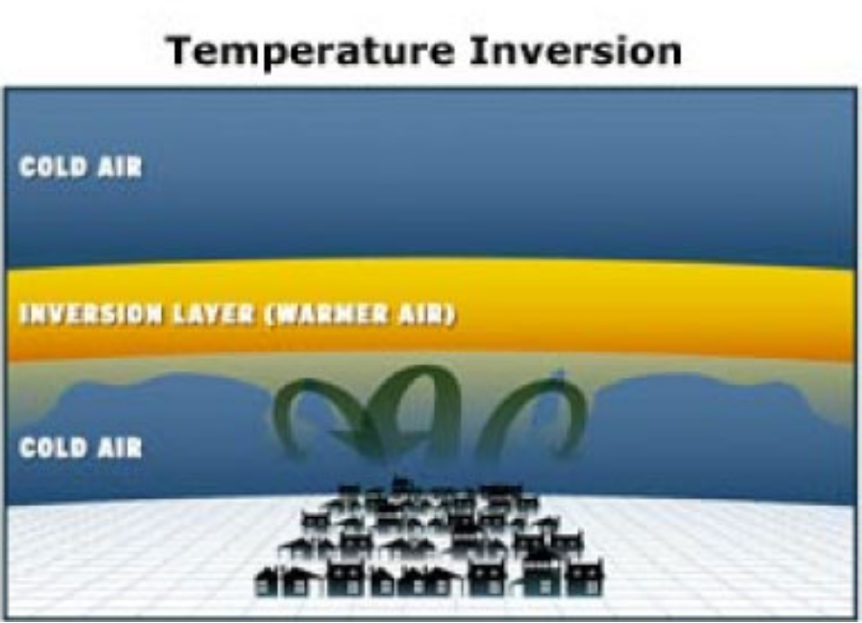
Daily Variations
Daily variations in PM₁₀ on high pollution / exceedance days generally show peak concentrations during the evening with a smaller peak occurring mid-morning.
These days are associated with key meteorological conditions of low wind speeds and a south-westerly wind direction which result in an inversion layer over Blenheim.
Due to the same source, domestic woodsmoke, PM_{2.5} and PM₁₀ show similar tracts both over time and generally concentrations with the bulk of PM₁₀ comprising PM_{2.5.}
marlborough.govt.nz

Slide 12
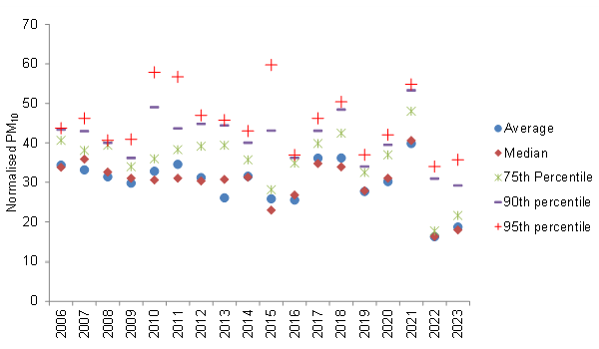
PM₁₀ Trends
Trends in PM₁₀ concentrations after adjusting for meteorological conditions
2023 was added to previous trend assessments of PM₁₀ concentrations for which variability resulting from meteorological conditions has been minimised.
If results for 2021 are disregarded owing to a localised source contributing to PM₁₀ that year, the results are indicative of a downward trend in PM₁₀
marlborough.govt.nz

Slide 13
Summary
In 2023, one exceedance of the NES PM₁₀ was recorded.
While 1 exceedance is allowed, due to the timing being less than a year since the previous exceedance Blenheim did not comply with the NES for PM₁₀ for 2023.
If results for 2021 are disregarded owing to a localised source contributing to PM₁₀ that year, the results are indicative of a downward trend in PM_{10.}
Amendments to the NES are still possible, likely to become stricter to align with update of the WHO Air Quality guidelines and HAPINZ model. Timescales are unknown.
While PM_{2.5} monitoring since 2017 shows a downward trend, Blenheim is unlikely to comply with any proposed changes to the NES.
More stringent air quality management for Blenheim is likely to be required when amendments come into effect.
marlborough.govt.nz

Slide 14

Questions?
marlborough.govt.nz

